Slide 1
INDUSTRY ORIENTED MINI PROJECT (IOMP)
REVIEW – I & II

Slide 2
BATCH - 2
PULKATI DHANA LAXMI - 23QM1A6695
RAVELLA PRANATHI - 23QM1A66A1
PEDDA KURVA SHIVA KUMAR - 23QM1A6691
NENAVATH JYOTHI - 23QM1A6682

Slide 3
Title
EarlyBloom - AI-Based Multimodal Early Autism Screening System

Slide 4
Problem Identification
Early detection of Autism Spectrum Disorder (ASD) is crucial for timely intervention and improved developmental outcomes.
Traditional diagnosis requires trained specialists and is often time-consuming and expensive.
Many parents lack access to early screening tools, especially in remote or underserved areas.
Delayed identification can negatively impact a child’s cognitive, social, and communication development.
Need: There is a need for an accessible, cost-effective, and technology-driven early screening solution.

Slide 5
Literature Survey
SI No | Paper Title | Year | Journal | Methodology / Algorithm | Findings | Drawbacks
1 | Artificial Intelligence-Based Multimodal Behavioral Analysis for Early Autism Detection in Children | 2026 | Preprint | Multimodal (facial expressions, eye gaze, speech, motor activity); CNN, SVM, Random Forest | Multimodal RF: 92% accuracy; CNN video: 87%; SVM speech: 82%; multimodal > single-modality | Limited dataset diversity; potential bias; ethical/privacy concerns; needs clinical validation
2 | Video-audio neural network ensemble for comprehensive screening of autism spectrum disorder in young children | 2024 | PLOS ONE | Video (VGG16-LSTM on OpenPose segments); Audio (1D-CNN on MFCC/chroma/etc.); Ensemble (decision tree) | Ensemble: 82.5% acc, F1 0.816; Video: 80%; Audio: 78.8%; tunable sensitivity/specificity | Limited to ADOS sessions; no early fusion; small test set (80 videos); clinical scalability untested
3 | Computer Vision-Based Assessment of Autistic Children: Analyzing Interactions, Emotions, Human Pose, and Life Skills | 2023 | IEEE Access | Activity: Spatio-temporal transformer (AVA dataset); FER: ResNet-34; JA: Head/hand pose (YOLO + Euler angles) | Activity: 72.3% acc; FER: 95.1%; JA gaze: 97%, pointing: 93.4%; real-time on 68 videos | Limited action classes (10); assumes 2-person; crowd/occlusion issues; needs larger ASD-specific data

Slide 6
SI No | Paper Title | Year | Journal | Methodology / Algorithm | Findings | Drawbacks
4 | A Machine Learning Framework for Early-Stage Detection of Autism Spectrum Disorders | 2023 | IEEE Access | Feature Selection + ML (AB, RF, SVM, LDA) | Up to 99.25% accuracy (Toddlers dataset) | No clinical validation; oversampling used
5 | Machine Learning Prediction of Autism Spectrum Disorder From Minimal Medical Information | 2024 | JAMA Network Open | XGBoost with SHAP explainability | AUROC up to 0.895 (train dataset) | Needs multi-site validation; parent-report bias

Slide 7
SI No | Paper Title | Year | Journal | Methodology / Algorithm | Findings | Drawbacks
6 | Deep Learning Autism Classification and Prediction | 2024 | International Robotics & Automation Journal | CNN on facial image dataset | 94% accuracy on image dataset | Limited dataset; no clinical comparison
7 | Early Detection of Autism Spectrum Disorder Using Gait Deviations and ML | 2025 | Scientific Reports | MediaPipe pose estimation + ML classifiers | 82% accuracy, AUC 0.97 | Small sample size; 2D pose limitations

Slide 8
SI No | Paper Title | Year | Journal | Methodology / Algorithm | Findings | Drawbacks
8 | Detection of Autism Spectrum Disorder in Children Using Machine Learning Techniques | 2021 | SN Computer Science | LR, NB, SVM, KNN, RFC classifiers | LR achieved 97.15% accuracy | Small dataset; class imbalance; limited to toddlers
9 | A Novel Automated Autism Spectrum Disorder Detection System | 2021 | Complex & Intelligent Systems | EEG features + SVM with polynomial kernel | 98.70% accuracy with selected features | Limited dataset; manual feature extraction

Slide 9
SI No | Paper Title | Year | Journal | Methodology / Algorithm | Findings | Drawbacks
10 | Application of Machine Learning Techniques to Detect Children with ASD | 2022 | Journal of Healthcare Engineering | Multimodal fusion (EEG + eye fixation + facial expression) | 87.5% accuracy using hybrid fusion | Small sample size (80 children); variability issues
11 | Detection of Autism Spectrum Disorder in Children and Adults Using Machine Learning | 2023 | Scientific Reports | Federated Learning with SVM and LR | Up to 99% accuracy for children dataset | Communication overhead; small dataset

Slide 10
Problem Statement Documentation
Early detection of Autism Spectrum Disorder (ASD) is essential for providing timely intervention and improving developmental outcomes in children. However, existing diagnostic methods are often time-consuming, expensive, and require access to trained medical professionals, making them less accessible to many families. Additionally, most current screening approaches rely on a single type of data, such as questionnaires, which may not capture the complete behavioral profile of a child. Therefore, there is a need to develop an accessible, cost-effective, and technology-driven system that leverages multiple data sources, including questionnaire responses, video, and audio inputs, to assist in early autism screening and provide a more comprehensive assessment of behavioral patterns.

Slide 11
Dataset Identification
Questionnaire Dataset: Early Autism Screening Dataset for Toddlers
Contains behavioral, demographic, and medical features
Includes target labels indicating ASD traits
The dataset is based on real screening data.

Slide 12
Data Understanding
Questionnaire Dataset:
Features include:
Behavioral responses (A1–A10)
Age
Gender
Family history and medical conditions
Target variable indicates presence or absence of ASD traits
Data is structured and suitable for classification models

Slide 13
Tool & Technology Selection
Frontend:
React (with Vite) for building user interface
TailwindCSS for styling
Backend:
FastAPI for API development
SQLAlchemy for database management
AI/ML Technologies:
ML Models: XGBoost (for questionnaire-based prediction)
gemini-2.5-flash
OpenCV for video processing and feature extraction
Librosa for audio analysis
Database:
SQLite
Authentication:
JWT (JSON Web Tokens) for secure user login

Slide 14
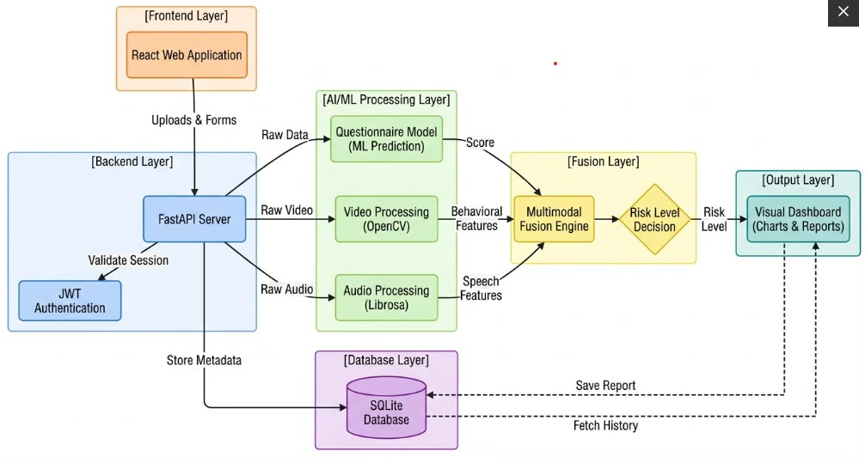
Architecure Diagram

Slide 15
Project Planning
The project is divided into the following phases:
Dataset collection and analysis
Data preprocessing and feature extraction
Machine learning model training
Backend API development
Frontend user interface development
Integration of ML models with backend
Testing and validation
Deployment and final evaluation

Slide 16
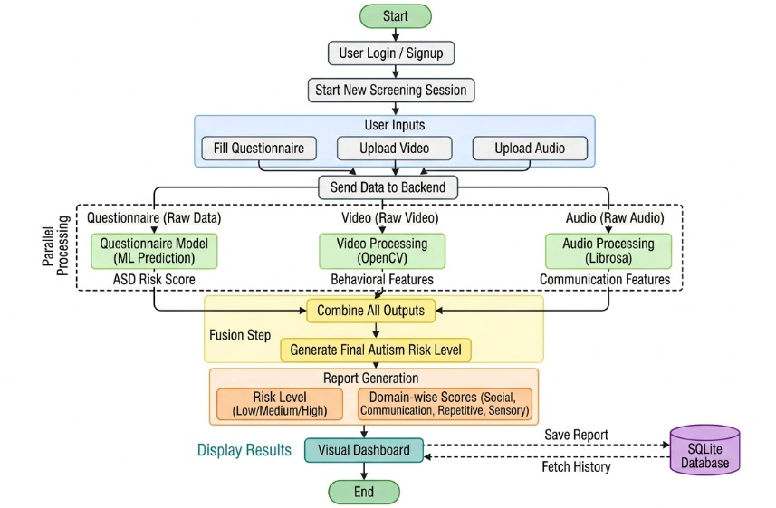
Workflow Diagram

Slide 17
Basic Implementation
Users provide input through questionnaire responses and multimedia uploads (video/audio).
Questionnaire data is processed using a trained machine learning model to predict ASD risk.
Video data is analysed using computer vision techniques to extract behavioral features.
Audio data is analysed to detect communication patterns.
Outputs from all modules are combined to generate a final risk assessment.
Provides personalised communication support and recommendations (speech exercises, social interaction guidance) based on the assessed risk level.
A medical chatbot that answers user’s queries and helps them
Nearby autism hospitals recommendations based on location
Final Output Includes:
Autism risk level (Low / Medium / High)
Domain-wise analysis (social interaction, communication, etc.)
Visual reports and insights
Personalised communication support recommendations

Slide 18
Individual Contribution
Team Member 1:
Responsible for designing the frontend structure using React and TailwindCSS, will develop user interfaces for forms, dashboard, and reports
Team Member 2:
Responsible for backend development using FastAPI, will handle API design, authentication (JWT), and database integration
Team Member 3:
Responsible for questionnaire dataset analysis and machine learning model development, will work on data preprocessing, feature selection, and model training
Team Member 4:
Responsible for multimodal analysis (video and audio), will work on feature extraction using OpenCV and LibrosaNote

Slide 19
Presentation & Communication
The team follows a structured and collaborative approach for project development.
Responsibilities are clearly divided among team members based on individual strengths.
Regular meetings are planned to discuss progress, challenges, and next steps.
Version control tools like GitHub will be used for collaboration and code management.
A phased development strategy will be followed to ensure timely completion of the project.

Slide 20
Data Preprocessing
Dataset: Autism screening data for toddlers by Fadi Thabtah (Kaggle) — 6,075 rows, 15 columns
Dropped Qchat-10-Score — data leakage (direct sum of A1–A10, label derived from it)
Encoded categorical columns: Sex, Ethnicity → LabelEncoder
Encoded binary columns: Jaundice, Family_ASD_History → Yes=1 / No=0
Target encoded: Class/ASD Traits → Yes=1 / No=0
Missing values filled with mode (categorical) and median (numerical)
Split: 80% train / 20% test, stratified by class
Dropping Qchat-10-Score is critical. The ASD label is assigned when score ≥ 3. Keeping it gives 100% accuracy (data leakage). Dropping it gives an honest ~98% learned from raw behavioral patterns.

Slide 21
Feature Engineering
Questionnaire Features (fed to XGBoost):
A1–A10: 10 binary behavioral answers (0 = typical, 1 = at-risk)
Age_Mons: Child age in months (12–36)
Sex: Male=1, Female=0
Jaundice: Yes=1, No=0
Family_ASD: Yes=1, No=0
Total: 14 features
Video Features (OpenCV + MediaPipe FaceMesh):
Eye contact ratio = eye contact frames / total frames (threshold: < 0.50 = at-risk)
Head movement std = std deviation of nose-tip frame-to-frame displacement (threshold: > 0.05 = at-risk)
Head movement mean = average displacement per frame
Face detected ratio = fraction of frames where face was detected
Rule-based scoring using clinical thresholds

Slide 22
Audio Features (Librosa):
MFCC (13 coefficients) — vocal timbre and speech texture
Pitch variability (Hz) — F0 std via librosa.piptrack() (normal range: 15–150 Hz)
Energy mean (RMS) — vocal loudness / flat affect indicator (threshold: < 0.015 = at-risk)
Energy std — variability in vocal energy
Speech rate (ZCR) — zero-crossing rate proxy (threshold: > 0.13 = at-risk)
Duration — audio clipped to max 60 seconds

Slide 23
Experimentation
Three models were trained and compared on the same leakage-free dataset:
Model | Purpose
Logistic Regression | Baseline — linear classifier
Random Forest | Ensemble — bagging approach
XGBoost | Primary model — gradient boosting
Experimental Setup:
All models: same train/test split (80/20, stratified)
Validation: 5-Fold Stratified Cross-Validation on full dataset
Metric: Accuracy + ROC-AUC (both evaluated to avoid bias toward majority class)
Hyperparameters tuned for XGBoost: n_estimators=300, max_depth=4, learning_rate=0.1, subsample=0.8, colsample_bytree=0.8

Slide 24
Key Experimental Decision — No Data Leakage:
Naïve approach (keeping Qchat-10-Score): 100% accuracy — misleading
Honest approach (dropping it): ~95–98% accuracy — model learns real behavioral patterns
This is the scientifically correct and defensible result

Slide 25
Model Implementation
Primary Model: XGBoost Classifier
Handles mixed feature types (behavioral + demographic)
Robust to outliers and missing patterns
Built-in feature importance scores
Faster training than deep learning for tabular data
Industry-standard for structured/tabular classification tasks
Comparison Models:
Random Forest
Logistic Regression

Slide 26
Multimodal Fusion Strategy:
Final Score = 0.60 × Questionnaire + 0.25 × Video + 0.15 × Audio
Questionnaire gets highest weight — clinically validated, most reliable signal
Video second — eye contact is a well-documented ASD indicator
Audio third — pitch/energy features are supportive but less specific
Risk levels:
Score 0–40 → Low Risk (green) — No significant indicators
Score 41–70 → Medium Risk (yellow) — Consult a specialist
Score 71–100 → High Risk (red) — Seek evaluation promptly

Slide 27
Performance Evaluation
Model Accuracy Comparison (Test Set):
Model | Accuracy | ROC-AUC
Logistic Regression | 89% | ~0.89+
Random Forest | 97% | ~0.97+
XGBoost (Primary) | 98% | ~0.99
XGBoost — 5-Fold Stratified Cross-Validation:
Mean CV Accuracy: ~97–98%
Standard Deviation: < ±1.5%
Consistent performance across all 5 folds — no overfitting
Evaluation Metrics Used:
Accuracy Score
ROC-AUC Score

Slide 28
Result Analysis
XGBoost — Final Results:
Test Accuracy: 98%
ROC-AUC: ~0.99
High Precision & Recall for both ASD and Non-ASD classes
Feature Importance (Top Behavioral Signals):
A1–A10 Q-CHAT behavioral responses are the strongest predictors
Questions related to eye contact, response to name, and social engagement score highest
Demographic features (age, sex, family history) add supporting context
Cross-Validation Results:
5-Fold CV confirms accuracy is stable (~97–98%) — not a result of lucky split
Low variance across folds → model generalizes well to unseen data

Slide 29
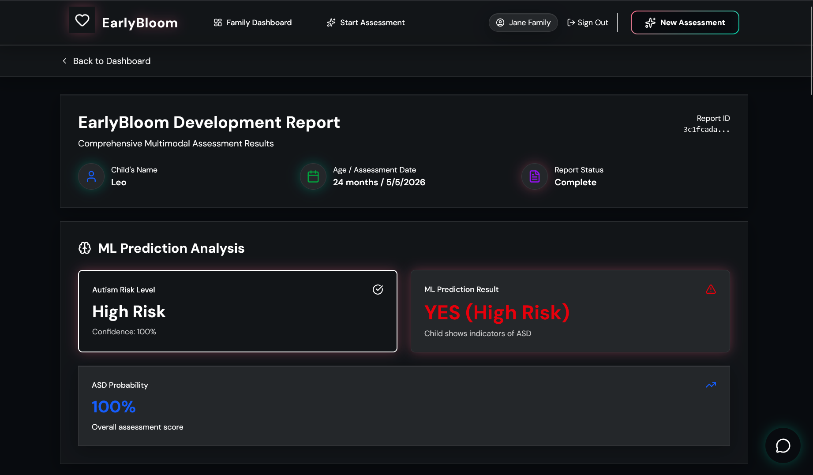

Slide 30
Code Quality
Frontend:
React 19 + Vite — component-based, fast HMR, optimized production builds
Custom hooks: useVideoAnalysis, useAudioAnalysis, useFullScreening — separation of concerns
React Hook Form — form validation without unnecessary re-renders
React Query — server state caching, background sync, loading/error states
Tailwind CSS — utility-first styling, no CSS conflicts
Error handling on every API call with user-friendly fallback messages
Backend:
FastAPI — async endpoints, automatic OpenAPI docs at /docs and /redoc
Service layer separation: video_processor.py, audio_processor.py, fusion.py, ai_interpreter.py
Try/except on every endpoint — 422/500 errors never crash the app
Gemini failure → rule-based fallback response served automatically

Slide 31
ML Pipeline:
Data leakage explicitly prevented — Qchat-10-Score dropped before training
StratifiedKFold CV — class-balanced validation
joblib serialization — model.pkl + label_encoders.pkl + feature_names.json
Input validation at inference using saved feature column order
All thresholds documented with literature citations
Standards:
API keys in .env — never hardcoded in source
File size limits enforced: video 50MB, audio 20MB

Slide 32
Progress Towards Deployment
Completed
Q-CHAT-10 dataset preprocessing and leakage removal
XGBoost model training — 99.18% accuracy, .pkl exported
FastAPI backend — auth, sessions, screening endpoints
MongoDB integration — users, session history, results stored
Video processing — OpenCV + MediaPipe feature extraction
Audio processing — Librosa MFCC, pitch, energy features
Multimodal fusion layer — weighted scoring with risk levels
Gemini AI integration — prompt engineered, fallback implemented
Deployment Plan:
Frontend → Vercel (free, auto-deploy from GitHub)
Backend → Render (free tier, FastAPI supported)
Database → MongoDB Atlas (free 512MB cluster)
Target: Demo-ready for viva presentation

Slide 33
Documentation
Dataset Documentation:
Source: Autistic Spectrum Disorder Screening Data for Toddlers — Fadi Thabtah (UCI / Kaggle)
18 features including 10 behavioral Q-CHAT items + demographics
Target: Class/ASD Traits (Yes/No)
Leakage column (Qchat-10-Score) identified, documented, and dropped
Model Documentation:
All model artifacts include metadata: feature names, class mappings, label encoders
Reproducible: fixed random_state, stratified splits, saved preprocessing objects

Slide 34
Documentation
Code Documentation:
Inline comments explain every major decision
Step-wise notebook structure (Steps 1–10) acts as self-documenting pipeline
API Documentation (FastAPI):
Auto-generated Swagger UI via FastAPI at /docs
Input schema: JSON with 10 behavioral questions + demographic fields
Output schema: prediction label, confidence score, risk level
Project Documentation (EarlyBloom):
README covers tech stack, setup instructions, and endpoint descriptions
Multimodal fusion logic documented with fallback behavior
Gemini chatbot includes fallback responses for API failure scenarios

Slide 35
THANK YOU!

